Slide 1
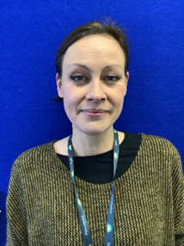
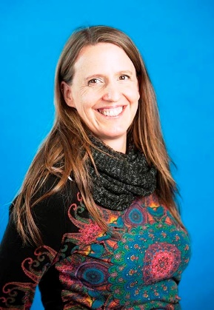
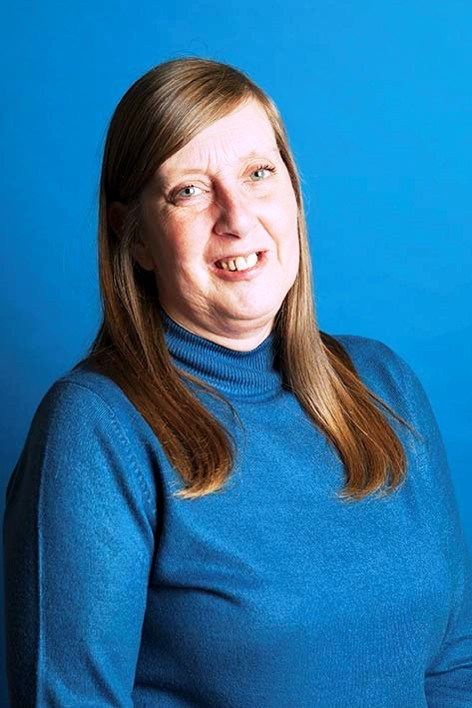
SAFEGUARDING CHILDREN
Safeguarding and Child Protection is at the forefront of our work with pupils at Pencalenick School.
Please refer ANY concerns regarding children’s safety to the School Designated Safeguarding Leads
Additional support and advice:
Multi Agency Referral Unit (MARU) for concerns about children. Tel: 0300 1231 116
Designated Officer (LADO) for concerns about adults working with children. Tel: 01872 326536
Child Exploitation and Online Protection Service (CEOPS) for advice about online concerns: ceop.co.uk
Whistleblowing and Safeguarding Governor: Joe Martin – 01872 520385 and SPT Safeguarding/ Whistleblowing Trustee: Alison Cook – 01872 520385. NSPCC Whistleblowing helpline: 0800 028 0285

